Slide 1
March 7, 2023
Central Square
Central School District
Staff Recognition
10 & 5 Years

Slide 2
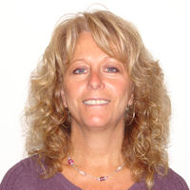
10 Years
Cindy Brown

Slide 3
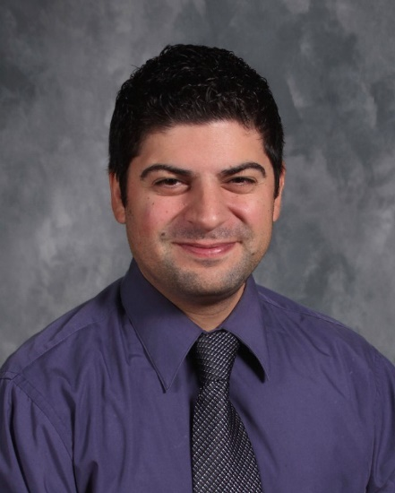
10 Years
Angelo Carroccio

Slide 4
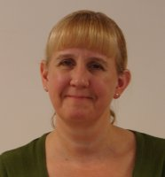
10 Years
Nancy Clark

Slide 5
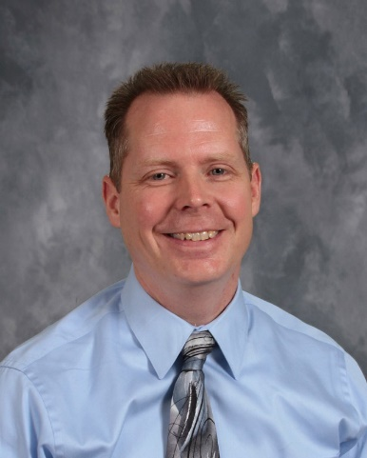
10 Years
Edward Darrh

Slide 6
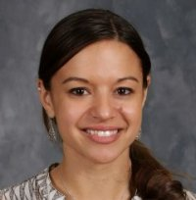
10 Years
Lindsey Ezzo

Slide 7
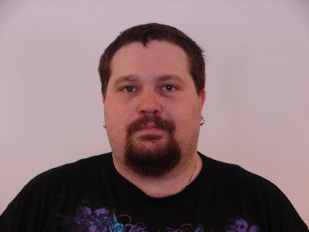
10 Years
Jason Hoyt

Slide 8
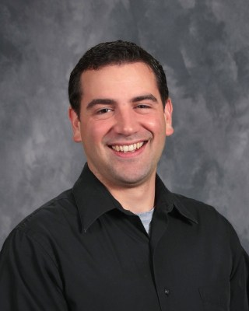
10 Years
Ronald Hurne

Slide 9
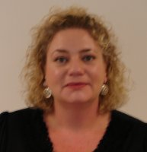
10 Years
Eileena Kelly

Slide 10
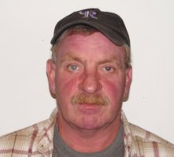
10 Years
John Landers

Slide 11
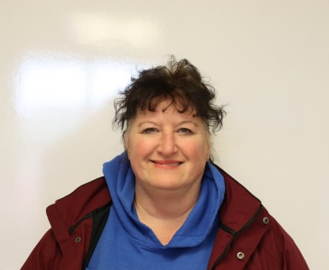
10 Years
Angela Last

Slide 12
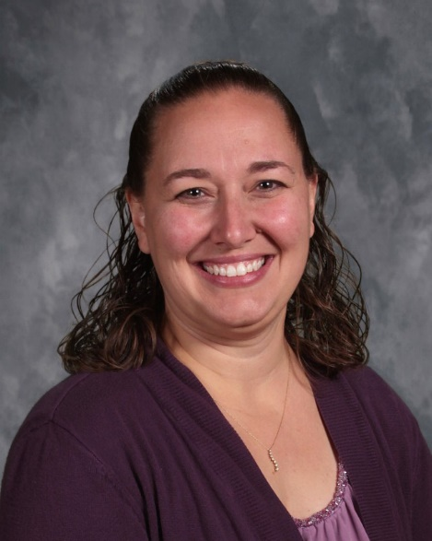
10 Years
Krista Lewis

Slide 13
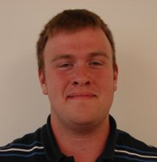
10 Years
Kevin Matteson

Slide 14
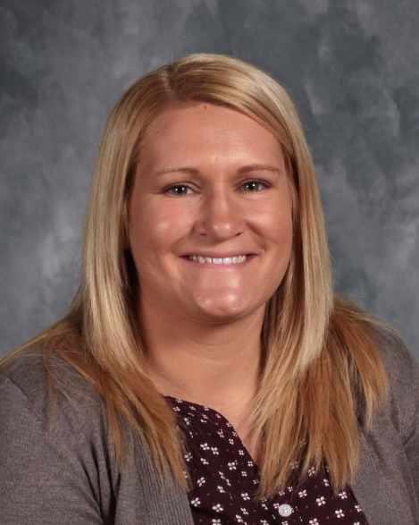
10 Years
Kyle Parra

Slide 15
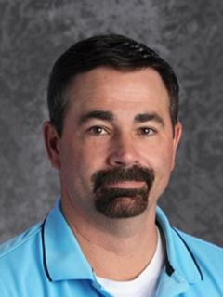
10 Years
Dean Porter

Slide 16
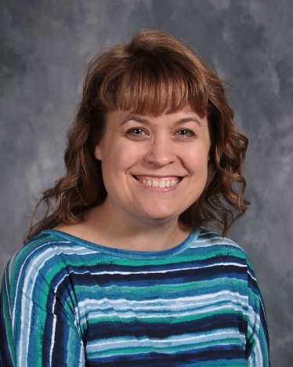
10 Years
Margaret Saunders

Slide 17
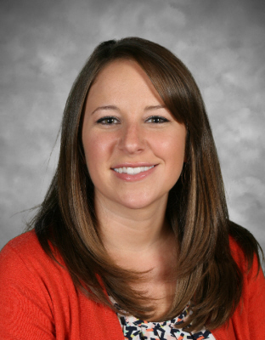
10 Years
Rebecca Shaughnessy

Slide 18
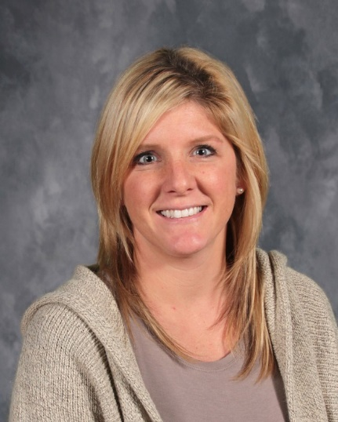
10 Years
Lindsey Stehle

Slide 19
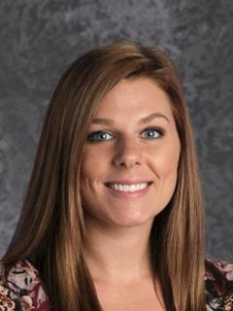
10 Years
Leanne Strader

Slide 20
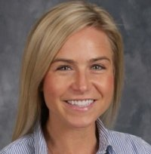
10 Years
Heidi Sullivan

Slide 21
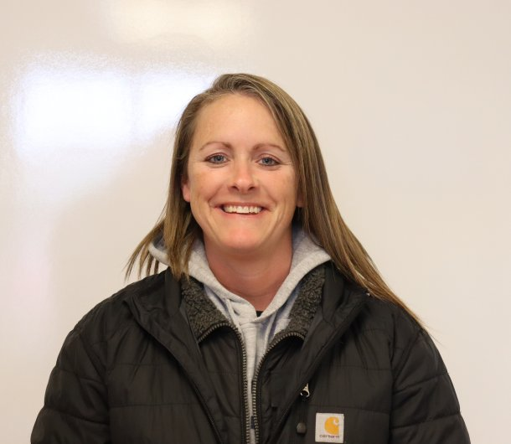
10 Years
Kelly Taylor

Slide 22
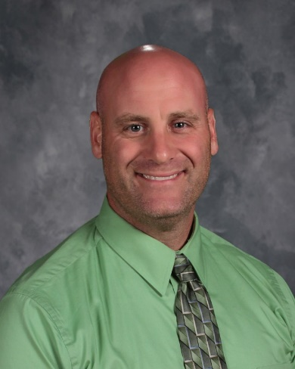
10 Years
Damon Villnave

Slide 23
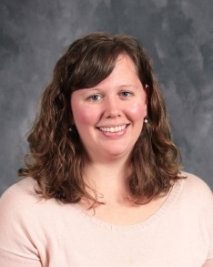
10 Years
Elizabeth Wallace

Slide 24
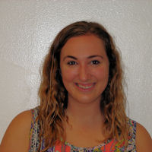
5 Years
Alyssa Anderalli

Slide 25
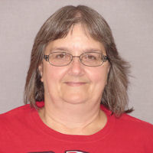
5 Years
Julia Anderson

Slide 26
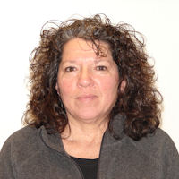
5 Years
Barbara Donaldson

Slide 27
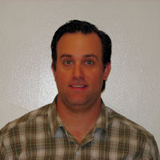
5 Years
Benjamin Feinberg

Slide 28
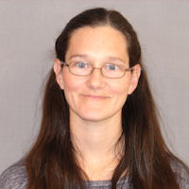
5 Years
Julie Frank

Slide 29
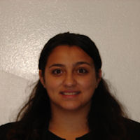
5 Years
Mia Galvan

Slide 30
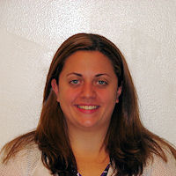
5 Years
Amanda Geiss

Slide 31
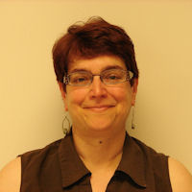
5 Years
Iraina Gerchman

Slide 32
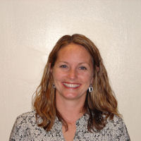
5 Years
Allyson Grados

Slide 33
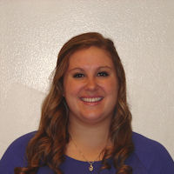
5 Years
Mackenzie Graham

Slide 34
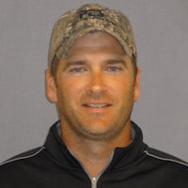
5 Years
Mark Green

Slide 35
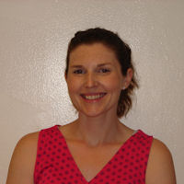
5 Years
Kristen Heffernan

Slide 36
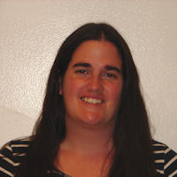
5 Years
Sarah Henderson

Slide 37
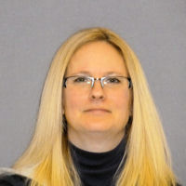
5 Years
Christina Karkowski

Slide 38
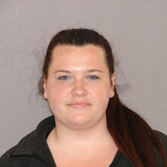
5 Years
Miranda Kenney

Slide 39
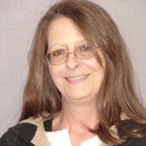
5 Years
Deborah Ladd

Slide 40
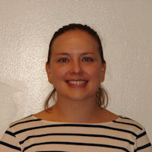
5 Years
Andrea Love

Slide 41
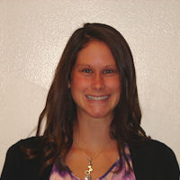
5 Years
Stacy Millert

Slide 42
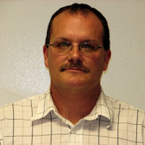
5 Years
Johnnie Pierce

Slide 43
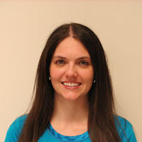
5 Years
Kayla Raut

Slide 44
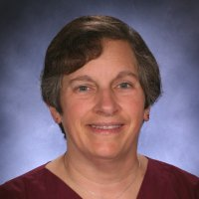
5 Years
Valerie Schwalm

Slide 45
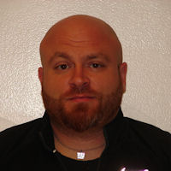
5 Years
Daniel Scicchitano

Slide 46
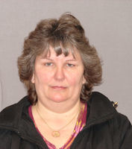
5 Years
Joanne Sliter

Slide 47
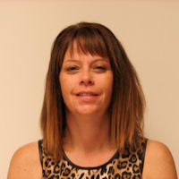
5 Years
Shannon Sofsky

Slide 48
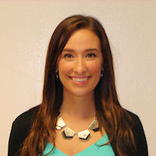
5 Years
Alexis Spadaro

Slide 49
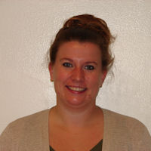
5 Years
Jennifer Tartaglia

Slide 50
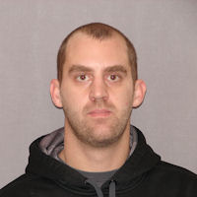
5 Years
Jordan Tiff

Slide 51
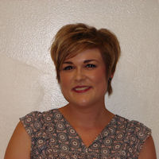
5 Years
Megan Vecchio

Slide 52
Thank you for your hard work and dedication to the Central Square School District. We appreciate all you do.

